Slide 1
Middle School Jeopardy
Various Topic Mid-term Review
Designed by
Lisa Rundall

Slide 2
How to Play Middle School Jeopardy
Choose a Category & Point Value from the Main Menu screen
Click on your Point Value choice
Read the answer that appears on the screen
Give your answer:
Answers must be given in the form of a question
Click on the button
Verify your answer with the information that pops up on the screen
Record any earned points on the score sheet
Click on to return to the Jeopardy board
Back to Main Menu

Slide 3
Main Menu
Geometry | Good Reads | Science | World Geography | L Vocabulary
100 | 100 | 100 | 100 | 100
200 | 200 | 200 | 200 | 200
300 | 300 | 300 | 300 | 300
400 | 400 | 400 | 400 | 400
500 | 500 | 500 | 500 | 500

Slide 4
The measurement of the surface of any polygon.

Slide 5
What is AREA?
Back to Main Menu

Slide 6
The measurement of the perimeter of a circle

Slide 7
What is CIRCUMFERENCE?
Back to Main Menu

Slide 8
A four-sided plane figure with opposite sides parallel

Slide 9
What is a PARALLELOGRAM?
Back to Main Menu

Slide 10
Two lines that intersect at a 90-degree angle

Slide 11
What are PERPENDICULAR LINES?
Back to Main Menu

Slide 12
A triangle with one angle measuring greater than 90 degrees

Slide 13
What is an OBTUSE TRIANGLE?
Back to Main Menu

Slide 14
A young girl transforms an abandoned garden into a place of beauty and happiness

Slide 15
What is THE SECRET GARDEN?
Back to Main Menu

Slide 16
A dog fights for survival in the frozen Yukon

Slide 17
What is CALL OF THE WILD?
Back to Main Menu

Slide 18
A young girl’s memories and personality are implanted in the body of a chimp

Slide 19
What is EVA?
Back to Main Menu

Slide 20
A teenager finds two different birth certificates with his name on them, he is plunged into a devastating family secret

Slide 21
What is I AM THE CHEESE?
Back to Main Menu

Slide 22
A strange and wonderful world in the woods where time stands still

Slide 23
What is THE BEGINNING PLACE?
Back to Main Menu

Slide 24
This term means the soil is frozen and its top surface thaws only during summer

Slide 25
What is TUNDRA?
Back to Main Menu

Slide 26
This planet has the most powerful storms

Slide 27
What is JUPITER?
Back to Main Menu

Slide 28
Movement of the outer layer of the Earth’s surface

Slide 29
What is PLATE TECTONICS?
Back to Main Menu

Slide 30
Rocky objects with strange shapes found in space and believed to be left over from the beginning of the universe

Slide 31
What are ASTEROIDS?
Back to Main Menu

Slide 32
The time period when dinosaurs roamed the Earth

Slide 33
What is PALEOZOIC?
Back to Main Menu

Slide 34
This is the longest river in the world

Slide 35
What is the NILE RIVER?
Back to Main Menu

Slide 36
Manila is this country’s capital

Slide 37
What is THE PHILIPPINES?
Back to Main Menu

Slide 38
This Kingdom possesses a quarter of the world’s proven oil reserves, and is the world’s largest producer and exporter of oil

Slide 39
What is SAUDI ARABIA?
Back to Main Menu

Slide 40
Over half of the world’s volcanoes arise in a belt called the Ring of Fire, located in this body of water

Slide 41
What is the PACIFIC OCEAN?
Back to Main Menu

Slide 42
The U.S. state that is the location of the building pictured here…

Slide 43
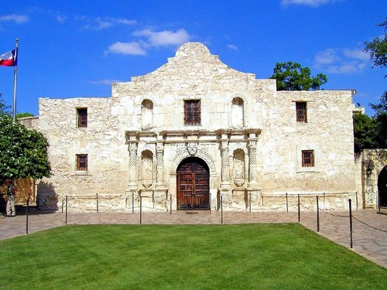
The Alamo picture

Slide 44
What is TEXAS?
Back to Main Menu

Slide 45
The words of a song

Slide 46
What is a LYRIC?
Back to Main Menu

Slide 47
The part of the body that contains the vocal cords

Slide 48
What is the LARYNX?
Back to Main Menu

Slide 49
A material like varnish that dries quickly into a shiny layer

Slide 50
What is LACQUER?
Back to Main Menu

Slide 51
A close connection

Slide 52
What is a LIAISON?
Back to Main Menu

Slide 53
A way of escaping something

Slide 54
What is a LOOPHOLE?
Back to Main Menu

